Slide 1
Deep Learning Capstone Project - Milestone 1
By: Thomas Abbott

Slide 2

Problem Definition
The problem I will look at in the first milestone is as follows: how will a convolutional neural network’s performance depends on the color scale of the dataset?

Slide 3


1. Why is this problem important
Computation Time If both color scales perform similarly, we could substitute complex color scale data sets with simpler color scales to significantly reduce computation time.
Access to Larger Datasets If a CNN performs equally well on a grayscale dataset, it would imply that future datasets could consist of grayscale images and hence be more accessible without a decrease in performance.

Slide 4
1. Key Questions/Objectives
Performance The primary goal is to determine whether CNN performance on the test set is affected when the data set color scale is RGB vs when it is grayscale.
Training Time
The secondary goal is to compare training times when using the RGB data set vs the grayscale dataset.

Slide 5
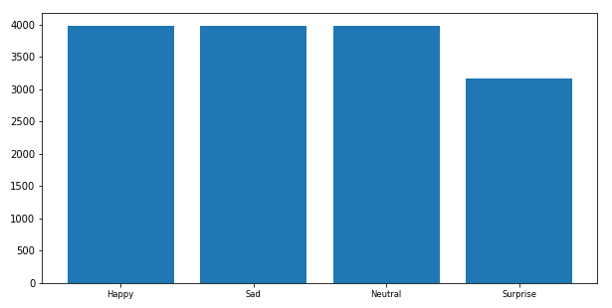
Data Exploration
The dataset consists of 20 230 images of human faces labelled with one of the following four emotions: happy, sad, surprise, or neutral.
We obtain the following histogram to better understand the distribution of classes among the training set.
Note:
We observe that several images in the dataset contain text. We proceed cautiously for now but may explore the effects of the text in future milestones.

Slide 6
Proposed Approach
Train the CNN on the Grayscale dataset
Train the CNN on the RGB dataset
Calculate Grayscale Training Time
Calculate RGB Training Time
Grayscale |  |  |  | RGB
Parameters:
Test Accuracy
Training Time

Slide 7
Measure of Success
The primary measure of success will be the test set accuracy. If the test set accuracies are very similar, the training time will be considered instead.

